Slide 1
Travelling Salesman Problem
using
Genetic Algorithm

Slide 2
A genetic algorithm is a search heuristic that is inspired by Charles Darwin’s theory of natural evolution. This algorithm reflects the process of natural selection where the fittest individuals are selected for reproduction in order to produce offspring of the next generation.

Slide 3
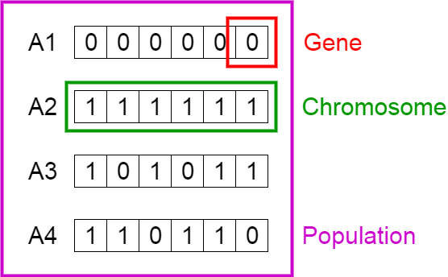
Five phases are considered in a genetic algorithm:
Initial population: We take a certain number of genes (variables) and group them in a chromosome(solution). These genes are characterisitcs of a set of individuals called population.
Fitness function: This helps us determine how fit an individual is. The probablity of an individual being selected for reproduction is based on its fitness score.

Slide 4
Selection: In this phase, the fittest individuals are selcted based on their fitness score and their genes are passed on to the next generation.
Crossover: The most important phase, here a random 'crossover' point is selected and the offsprings are created by the exchange of genes among the parents until the crossover point is reached.
Mutation: The genes of some offspring can be mutated to maintain diversity among the population.

Slide 5
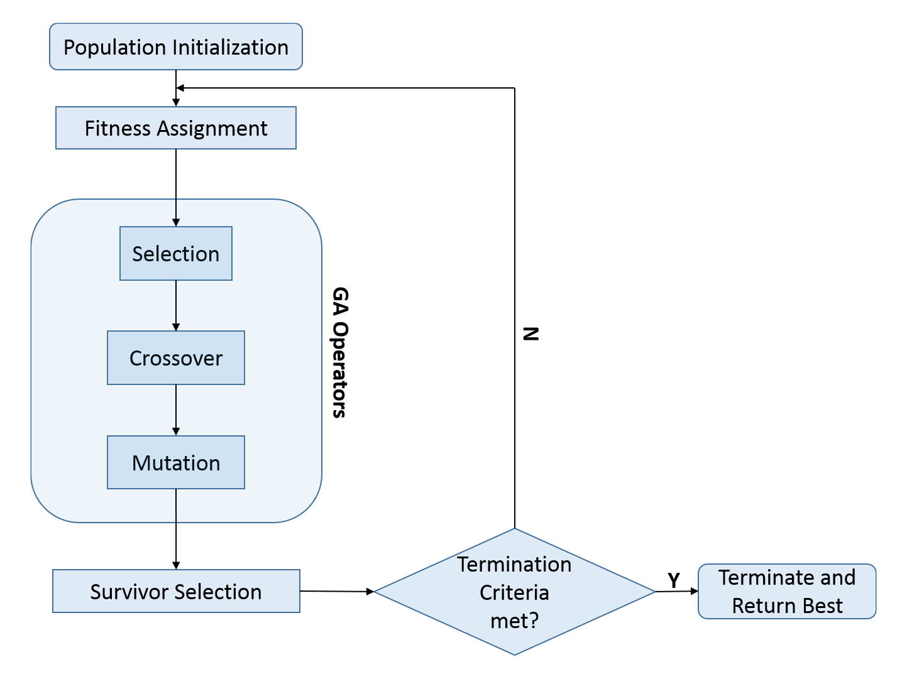
Genetic Algorithm Flowchart

Slide 6
Travelling Salesman problem is an optimisation problem where a salesman is given the task to travel from an origin city to various given cities and back to the origin city with the shortest possible route.
Given this, there are two important rules to keep in mind:
Each city needs to be visited exactly one time
We must return to the starting city, so our total distance needs to be calculated accordingly

Slide 7
We will solve this problem using genetic algorithm. With reference to TSP, genetic algorithm will be defined as the following:
Gene: a city (represented as (x, y) coordinates)
Individual (aka “chromosome”): a single route satisfying the conditions above
Population: a collection of possible routes (i.e., collection of individuals)
Parents: two routes that are combined to create a new route
Mating pool: a collection of parents that are used to create our next population (thus, creating the next generation of routes)
Fitness: a function that tells us how good or short each route is.
Mutation: a way to introduce variation in our population by randomly swapping two cities in a route
Elitism: a way to carry the best individuals into the next generation

Slide 8
First we create the genes or list of cities needed to be visited.
From the genes, we need to create the population i.e. the routes.
Then, each route will be given a certain fitness score which will help us determine the best possible route from one gene to another.
The best possible routes are selected to create the next generation of individuals.

Slide 9
For TSP, we use a process called ordered crossover to create the next generation where each city is only visited once. A subset of the first parent string is selected and the remaining route is filled using the genes of the second parent to prevent duplication of genes(cities).
After generalising this, we can get our offspring population.
Mutation in the case of TSP refers to the different possible routes which will give us the optimal solution. Here, instead of swapping variables like 1 or 0, we will swap two cities.
All these processes are repeated until the final solution which will give us the best possbile route for the salesman to travel from the origin city to given cities and then back to the origin.

Slide 10
THANK YOU!

